Slide 1



Heart Failure Prediction
By: Sneha Kumaran
CDS 403
Term Project

Slide 2
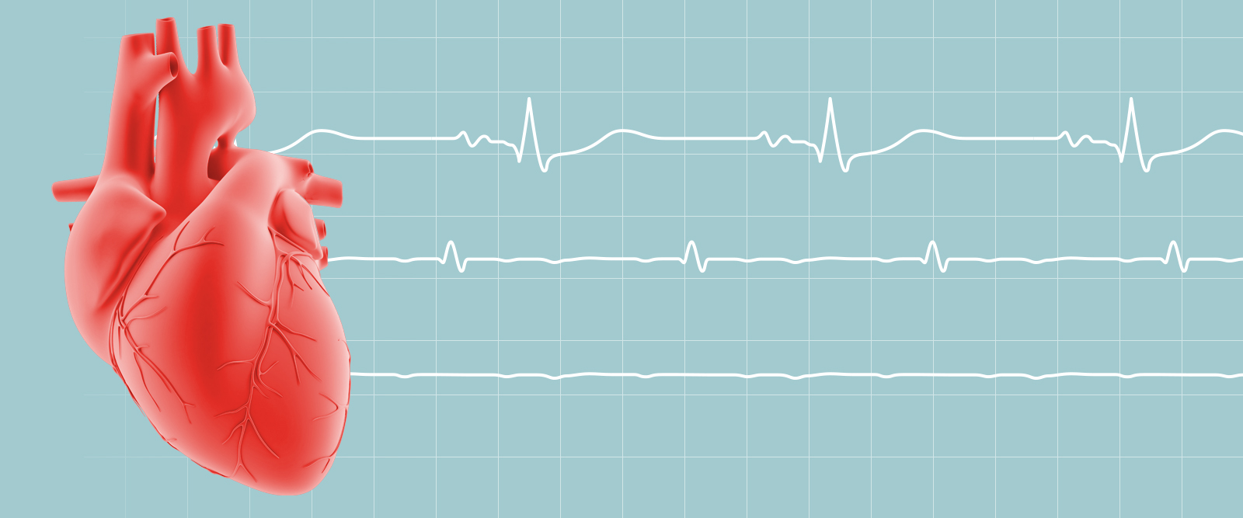
PROBLEM
A data of 918 patients were collected about their health information and the characteristics regarding the conditions that could potentially affect the heart. These features are looking towards to see whether a patient would be classified to have a heart failure or not.
So, using a machine learning algorithm, particularly a decision tree (classification algorithm), I can classify which patient would have a heart failure based on the given features in the dataset.
Dataset: https://www.kaggle.com/datasets/fedesoriano/heart-failure-prediction

Slide 3
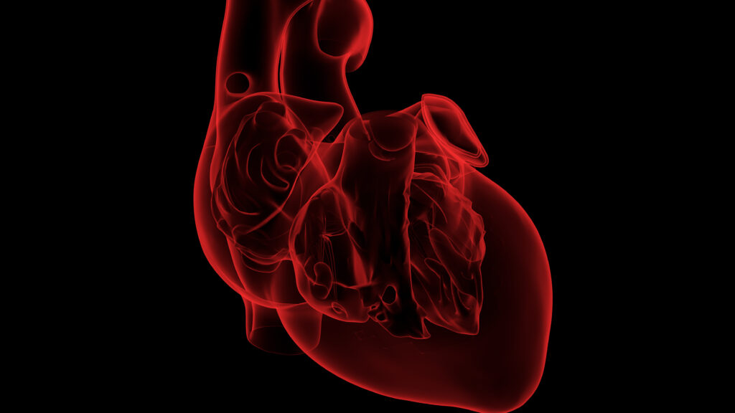
DATA
918 patients/ 919 rows/ 13 columns
Attributes:
Age - Patient’s age
Gender – Male or Female
ChestPainType - chest pain type (TA: Typical Angina, ATA: Atypical Angina, NAP: Non-Anginal Pain, ASY: Asymptomatic)
RestingBP- resting blood pressure (mm hg)
Cholesterol – Serum Cholestrol (mm/dl)
FastingBS - fasting blood sugar (1: if FastingBS > 120 mg/dl, 0: otherwise)

Slide 4
DATA
RestingECG - resting electrocardiogram results (Normal: Normal, ST: having ST-T wave abnormality, LVH: showing probable or definite left ventricular hypertrophy by Estes' criteria)
MaxHR - maximum heart rate achieved [Numeric value between 60 and 202]
ExerciseAngina - exercise-induced angina [Y: Yes, N: No]
Oldpeak - oldpeak = ST [Numeric value measured in depression]
ST_Slope - the slope of the peak exercise ST segment [Up: upsloping, Flat: flat, Down: downsloping]
HeartDisease - output class [1: heart disease, 0: Normal]

Slide 5
METHOD
Chose the decision tree algorithm, because I wanted to see how well this algorithm can perform and see how to roots down based on other attributes
Steps/Method of getting the classification/decision tree:
Imported the CSV file from Kaggle
Analyzed the dataset and checked the summary of the dataset about each column
Displayed the table from the dataset to view RestingBP, Cholesterol, and Heart Disease
Set seed to 3437 (randomly)
Created a training sample
Split the dataset into the training set and test set using the train_sample
heart_train
heart_test

Slide 6
METHOD
Analyzed the proportion table using the training/testing set and heart disease
Installed package C50 to fit the training set into the decision/classification tree
Predicted the test results and used the gmodels package to create a Cross Table
Improved the model by using adaptive boosting and ran for 24 iterations
Installed Caret Package
Found the Accuracy of how well the algorithm worked, Recall, Precision, and F1 Score

Slide 7
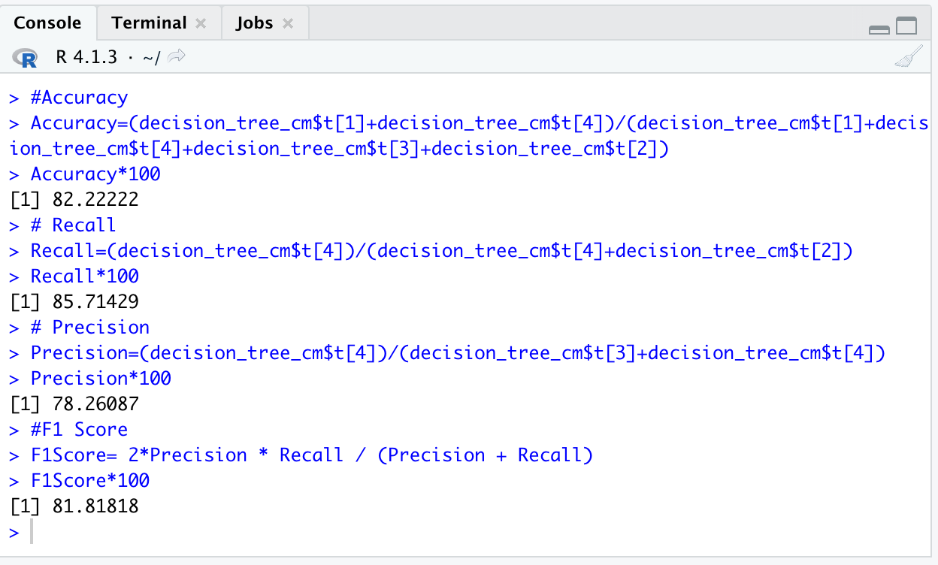
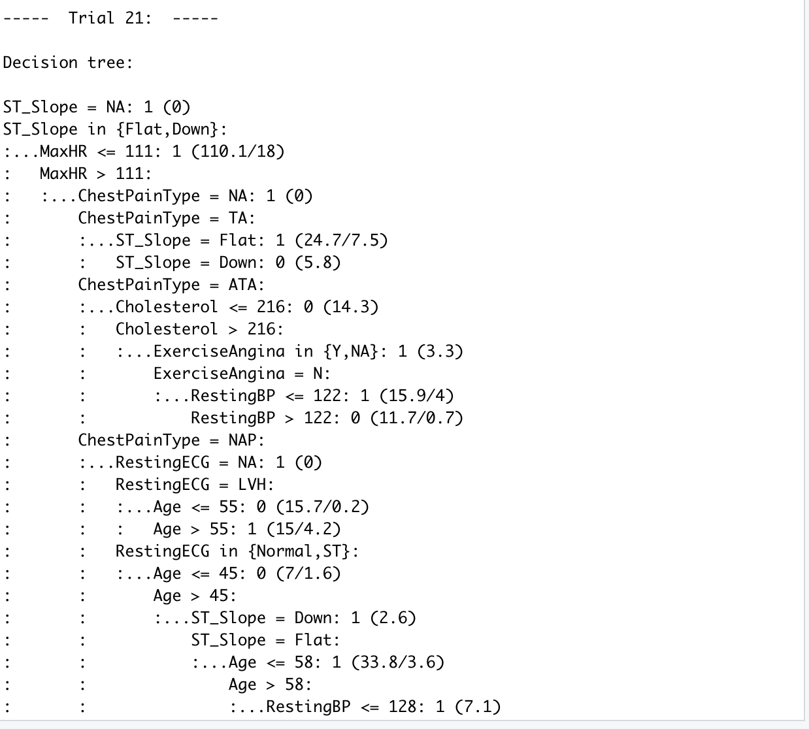
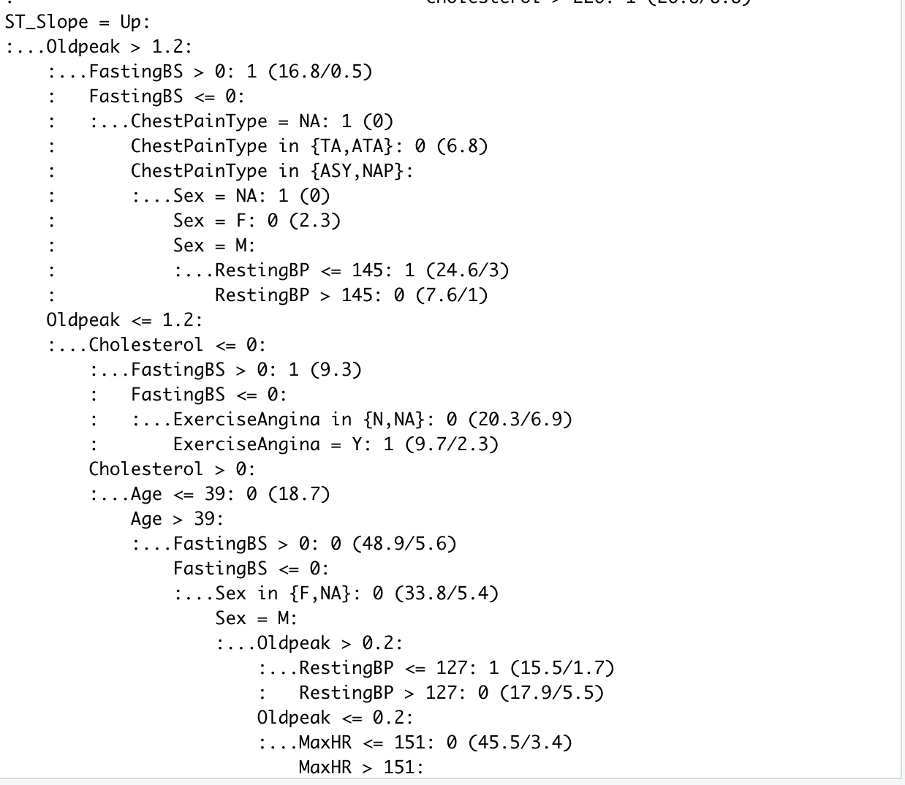
RESULTS
Here is an example of the decision tree after the boosting. Below is the example of trial 21, where it starts out with ST_Slope and roots down to multiple attributes to which are 0 or 1 (heart disease or don’t have)
Below is the overall accuracy, recall, precision, and F1 score of how well the algorithm worked.

